Slide 1
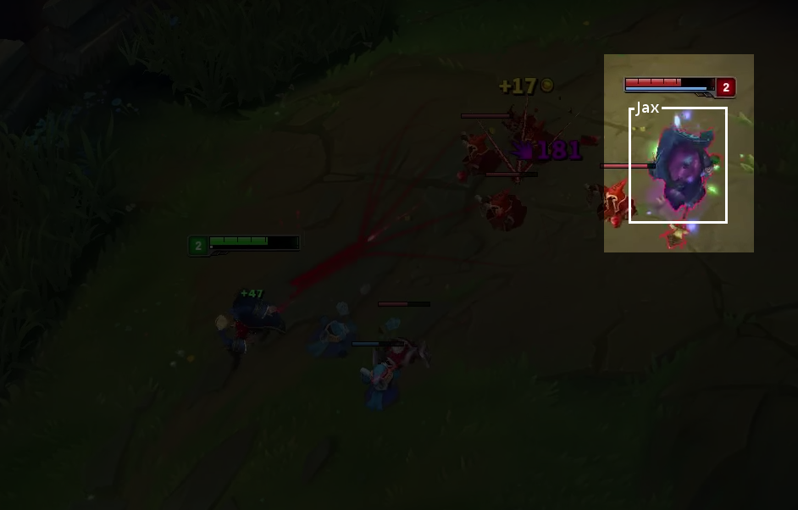
Champion Annotator
Thomas Dil, Ben Kulbago, Tim McDaniel, Daniel Schnipke
League of Legends is a widely popular video game with many videos of it created every day
Our proposal is to write a program that can locate and identify champions within these videos, and then annotate them
134 different champions to identify, well over 10,000 hours of youtube content, program to create more content
Expected Challenges
Wide variety of poses and orientations for each character
Some champions use similar colors
Spells/flashy particle effects impacting characters
Sample Annotation

